Slide 1


Adult Census Income Prediction
Umang Tank

Slide 2


Objective
Dataset
Data Description
Architecture
Data analysis steps
EDA
Database connectivity
Model Selection
Prediction Result
Deployment
Question & Answer

Slide 3
Objective
Census data is aim to increase the awareness about how the income factor actually has an impact not only on the personal lives of people, but also an impact on the nation and its betterment.
We will today have a look on the data extracted from the 1994 Census bureau database, and try to find insights about how different features have an impact on the income of an individual. Though the data is quite old, and the insights drawn cannot be directly used for derivation in the modern world, but it would surely help us to analyze what role different features play in predicting the income of an individual.

Slide 4
Dataset
The dataset provided to us contains many rows, and 13 different independent features. We aim to predict if a person earns more than 50k$ per year or not. Since the data predicts 2 values (>50K or <=50K), this clearly is a classification problem, and we will train the classification models to predict the desired outputs.

Slide 5
Data Description
Age — The age of an individual, this ranges from 17 to 90.
Workclass — The class of work to which an individual belongs.
Education — Highest level of education
Education_num — Number of years for which education was taken
Marital_Status — Represents the category assigned on the basis of marriage status of a person
Occupation — Profession of a person

Slide 6
Relationship — Relation of the person in his family
Race — Origin background of a person
Sex — Gender of a person
Capital_gain — Capital gained by a person
Capital_loss — Loss of capital for a person
Hours_per_week — Number of hours for which an individual works per week
Native_Country — Country to which a person belongs
Output:
Income — The target variable, which predicts if the income is higher or lower than 50K$.

Slide 7
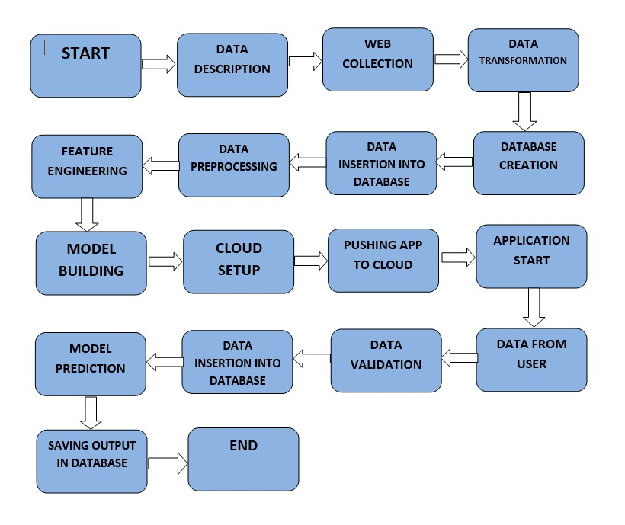
Architecture

Slide 8
Data Analysis steps
MODEL
DATA
DATA
EXPLORATORY DATA
FEATURE
CREATION AND
COLLECTION
PREPROCESSING
ANALYSIS
SELECTION
EVALUATION
In step 1, we collect
In step 2, we
In step 3, we explore
In step 4, we use
In step 5, we finally
data which is generally
preprocess the data
the data by performing
feature selection
build models on our
present in a database
which involves data
univariate and
techniques to filter out
dataset and choose
or on internet.
cleaning by handling
bivariate analysis on
the most important
the model which gives
outliers, null values
the features.
features to perform
the best accuracy.
etc.
model creation

Slide 9
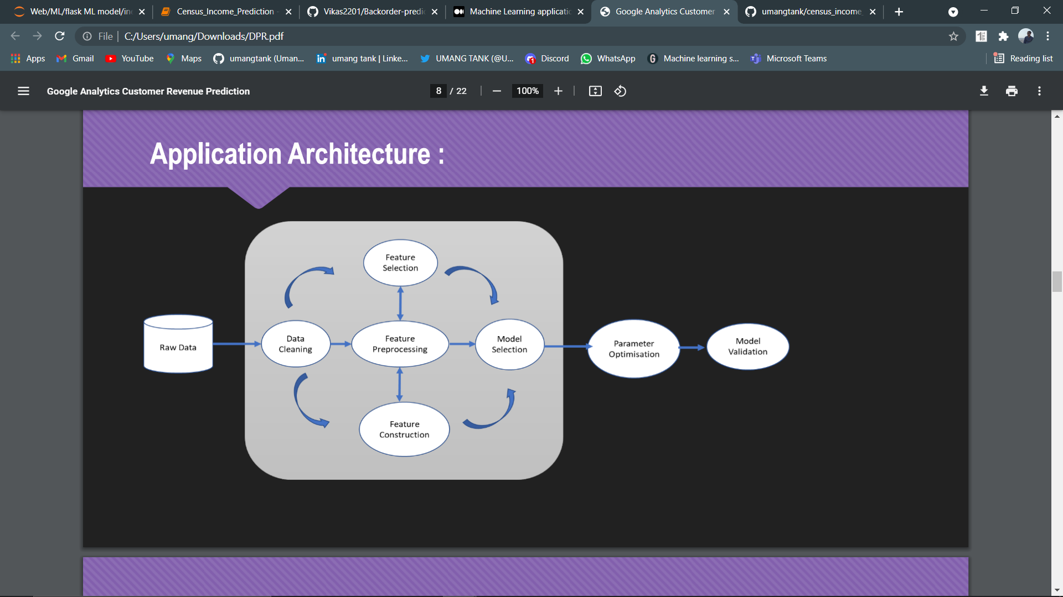

Slide 10
EDA
Missing value count
No of rows and columns(Shape)
categorical/Numerical columns
Correlation heat map
Null value handling(impute null value)
Skewness and log transformation

Slide 11

Database
Database creation and connection :
Table Creation : we have to create a table, if Table is already created then we need to insert new data into database.
Insertion : All valid input data are inserted into the tables

Slide 12
Model Selection
Evaluates classification models using Logistic Regression ,Random forest , Decision Tree, SVC & Ada Boost classifier.
Compute metrics and generate graphs for model evaluation and importance analysis
Finally, we fit the Ada boost classifier model with optimal tuning parameters on the entire dataset. We then could use this model to predict Income.

Slide 13
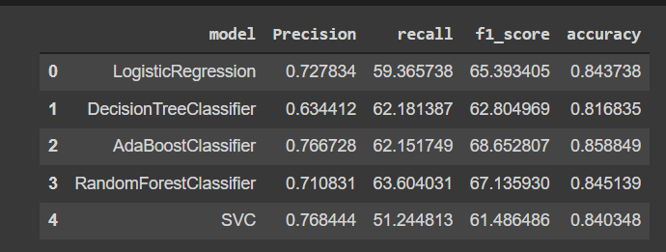
Model Prediction Result on test dataset

Slide 14

Model Deployment
The final model is deployed using on Heroku using Flask framework

Slide 15
Question & answer
Question 1. Explain about the Project and your day to day task :
The aim is to build models to determine the income level of the people in U.S. It is a binary classification problem to predict if an individual has an income higher than $50k/year.
As a data scientist I am involving in each an every phase of the project. My responsibility consisted of gathering the dataset ,labelling the data for the model, training the model on the prepared dataset , deploying the training model to the cloud, monitoring the deployed model for any issues.

Slide 16
Question 2: What is the source and size of data ?
Kaggle - https://www.kaggle.com/overload10/adult-census-dataset, Size of the data usually in MB.
Question 3: What was the type of data?
The data was the combination of numerical and Categorical values.
Question 4: What is Precision and Recall ?
Precision: Out of all the points to be predicted Positive, How many of them are actully Positive.
Recall: Out of all the points that are lebelled positive, how many of them are predicted Positive.

Slide 17
Question 5 : What techniques r you using for data pre-processing ?
Removing unwanted attributes.
Visualizing relation of independent variables with each other and with dependent variable.
Cleaning data and imputing if null values are present.
Convert Categorical data to numerical data.
Scaling the data.
Question 6 : Does Your Dataset Show Normally Distributed Or Not? If Not Then Which Techniques You Will Use To Make It Normal?
No, These Data Set Does Not Show Normal Distribution Behavior. I Used Log Transformation Techniques To Make It Normally Distributes.

Slide 18
Question 7 : Which Tool You Are Used For Implementation This Model?
IDE : VS Code
Cloud : Heroku
DataBase : MySql
Question 8: In which technology you are most comfortable?
I have worked in machine learning and beginner in deep learning.
Question 9 : What Is Accuracy ?
Accuracy Is One Metric For Evaluating Classification Models.
Accuracy = Number Of Correct Predictions /Total Number Of Prediction.

Slide 19
Question 10 : How did you optimize your solution?
Model optimization depends on various factors
Train with better data or do data pre-processing in efficient way.
Increase the quantity of training data etc.
Try and use multithreaded approaches
Question 11 : How Will You Know Which Machine Learning Algorithm to Choose for Your Classification Problem?
While there is no fixed rule to choose an algorithm for a classification problem

Slide 20
Thank You

